Slide 1
Building responsive Single page application using angularjs
View AngularJS course details at www.edureka.co/angular-js
For Queries :
Post on Twitter @edurekaIN: #askEdureka
Post on Facebook /edurekaIN
For more details please contact us:
US : 1800 275 9730 (toll free)
INDIA : +91 88808 62004
Email us : sales@edureka.co

Slide 2
Objectives
At the end of the session you will be able to learn:
Why should we use AngularJS
What is AngularJS
MVC & MVW Architecture
AngularJS Features
How to build a responsive single page application

Slide 3


Slide 4
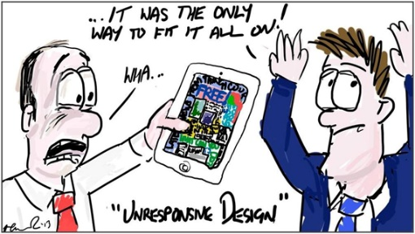
Challenges of Web Development
Responsiveness with different devices

Slide 5

Challenges of Web Development
Responsiveness with different devices
Diverse User Preferences

Slide 6

Challenges of Web Development
Responsiveness with different devices
Diverse User Preferences
Agility to server new requests with enterprise standards

Slide 7

Challenges of Web Development
Responsiveness with different devices
Diverse User Preferences
Agility to server new requests with enterprise standards
Multiple Skill Sets

Slide 8

Challenges of Web Development
Responsiveness with different devices
Diverse User Preferences
AngularJS will solve these problems
Agility to server new requests with enterprise standards
Multiple Skill Sets

Slide 9


Slide 10

What is AngularJS?
AngularJS was originally developed in 2009 by Misko Hevery and Adam Abrons at Brat Tech LLC, firstly named as GetAngular
OpenSource client side JavaScript framework created by Google
Designed for web developers and designers, who need to have more control over their web Applications
AngularJS accomplishes a lot by embracing HTML, JavaScript and CSS

Slide 11

What is AngularJS a/c to Misko Hevery ?
A better way to think about angular is not to think about it as framework but as HTML compiler which allows you to create your OWN DSL in HTML, by attaching your own behavior to any HTML element, attribute or text. And by any I mean that you can make up your own names (outside those of HTML spec)
Misko Hevery

Slide 12


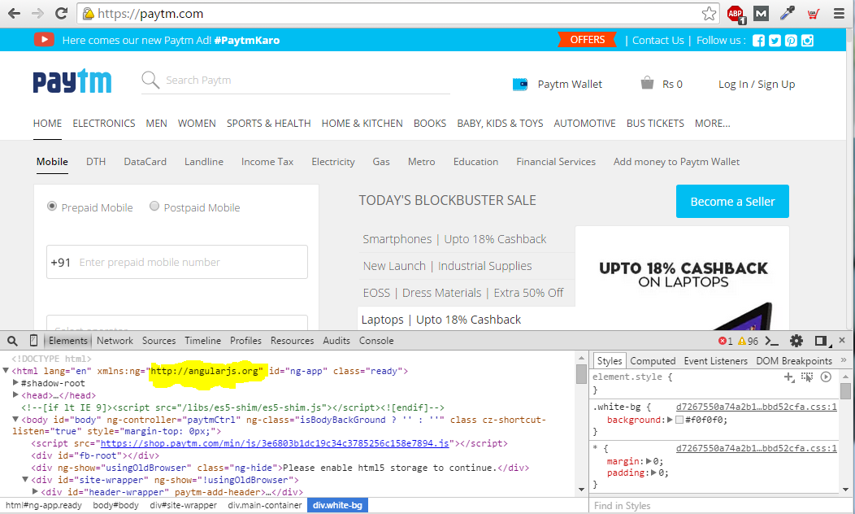

Big Brands Using AngularJS
YouTube application for Sony's PlayStation 3

Slide 13

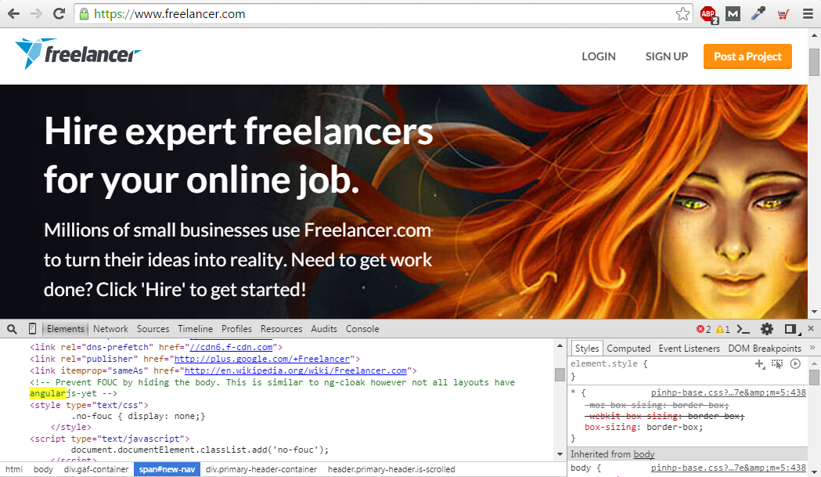

Big Brands Using AngularJS

Slide 14


Let us see what is Single Page Application first
SPA
AngularJS
TakeAway

Slide 15
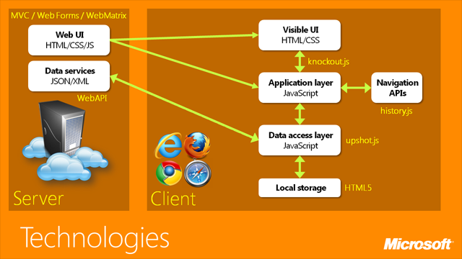
SINGLE PAGE APPLICATION
Single Page Application is a web app in which the majority of interactions are handled on the client without the need to reach a server, with a goal of providing a more fluid user experience
Client Side Routing
Client Side Rendering
Reference: https://channel9.msdn.com/

Slide 16
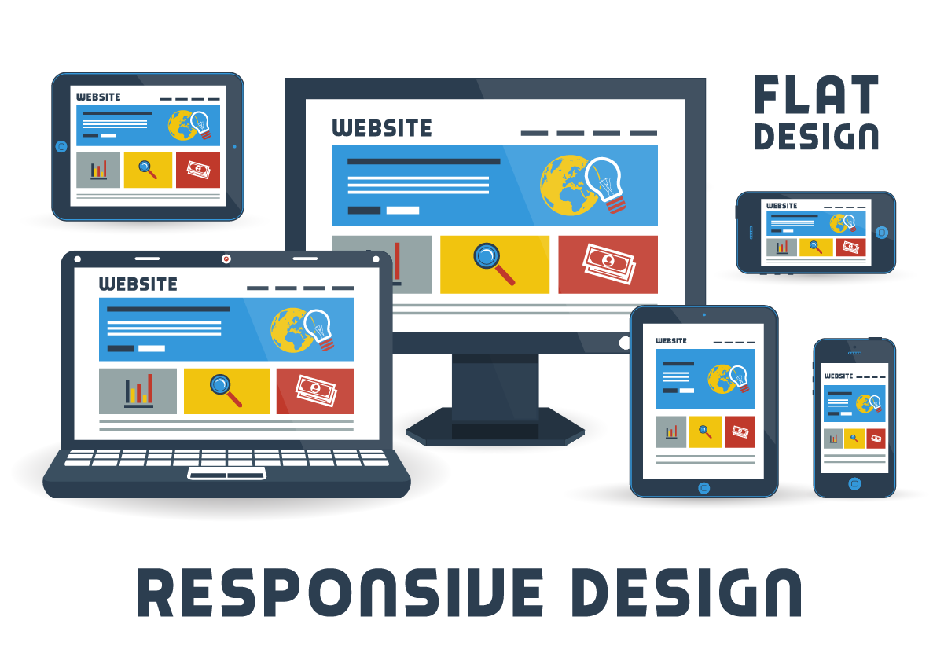
RESPONSIVE SINGLE PAGE APPLICATION

Slide 17




AngularJS in Detail
SPA
AngularJS
TakeAway

Slide 18
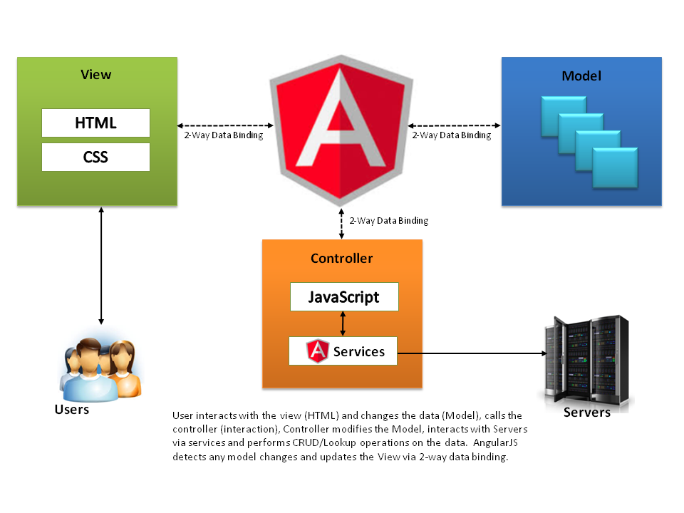

MVC & MVW Way of AngularJS
MVC
MVW
Model
View
HTML
CSS
Whatever
Controller
Directive
Unit Test
Reference: Avaldes.com

Slide 19
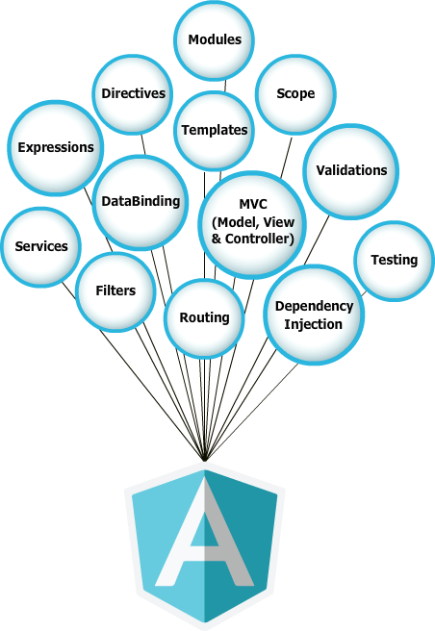
Features of AngularJS

Slide 20


Slide 21
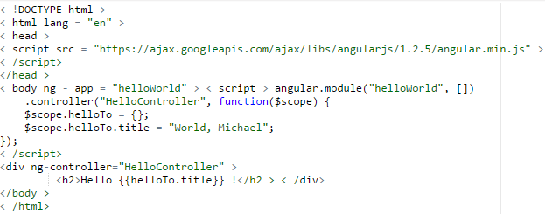
AngularJS: Your first program
Steps to create an AngularJS Application
Include AngularJS
Bootstrap the App
Create the Controller
Create the View
Run the Application

Slide 22
Building Highly Responsive Single Page Application
Usecase : Build a User Management Application
Prerequisite :
Text Editor (sublime or notepadd ++)
Latest browser (Firefox or Chrome)
Installed NodeJS (server)
Mongo (To store userinfo)
Project Specifications :
Login to the Application
Create a new user
View Users List
Update a existing user
Delete user
Signout

Slide 24
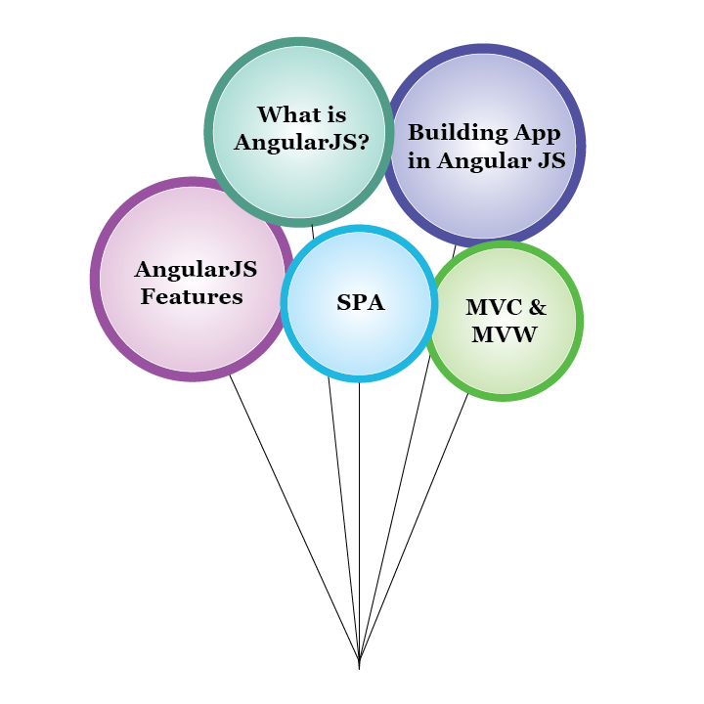





AngularJS: Your first program
SPA
AngularJS
TakeAway

